Slide 1
Interpolation and Mapping
CSCI 4150/6050: Computer Vision

Slide 2
Image Warping
The process of transforming an image from one space to another.
Requires a mapping of points from one space to the other.
Key Idea: Whenever an image warp takes place, the new image must always be interpolated from the old image values.

Slide 3

Interpolation
Interpolation is taking continuous values and mapping them to discrete values.
Used to estimate a function between known sampled values
Digital signals to analog
  Audio playback
  Image display
Spatial image manipulation
  Changing size
  Rotation
  Warping

Slide 4
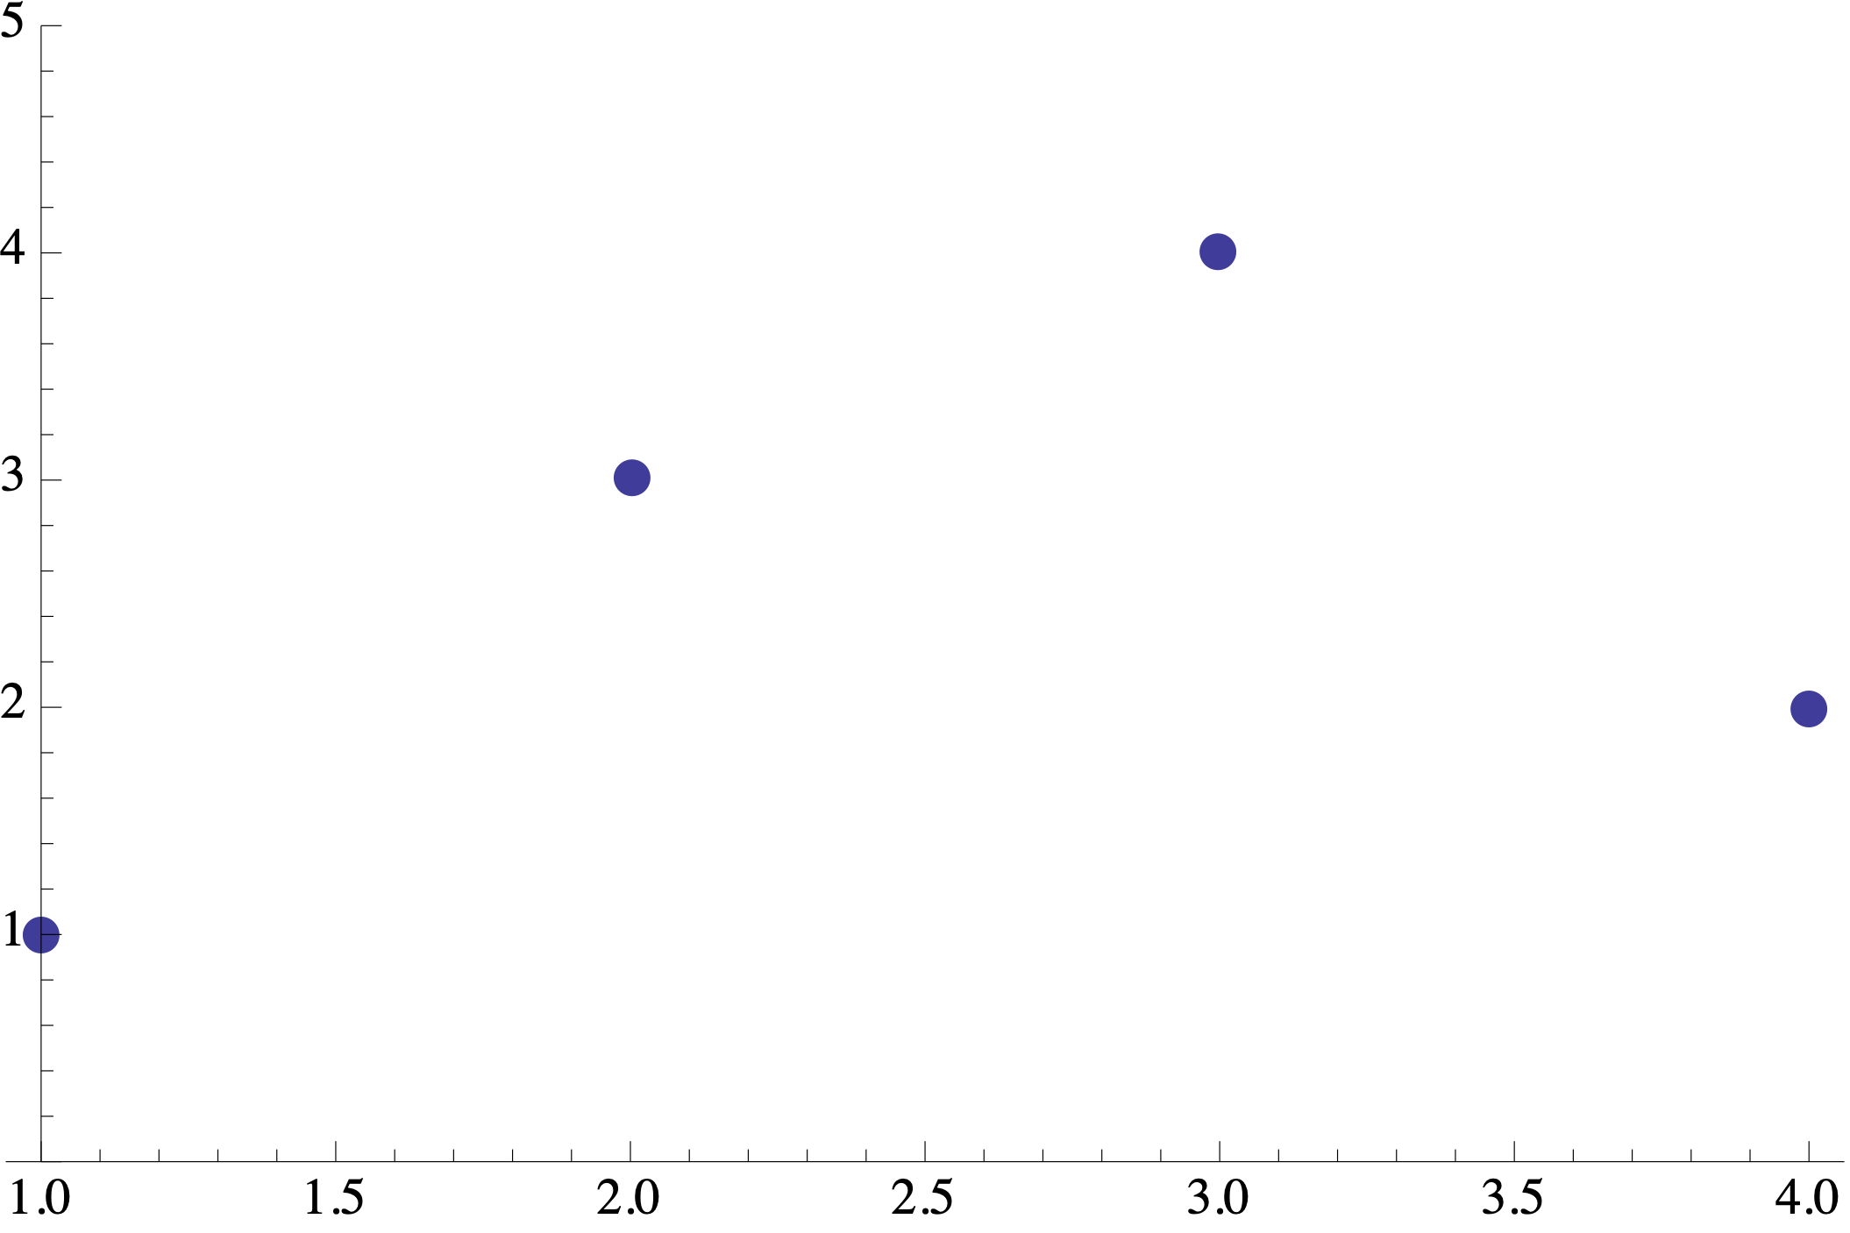
Interpolation
What do the signals inbetween look like? We don’t know but we estimate.

Slide 5
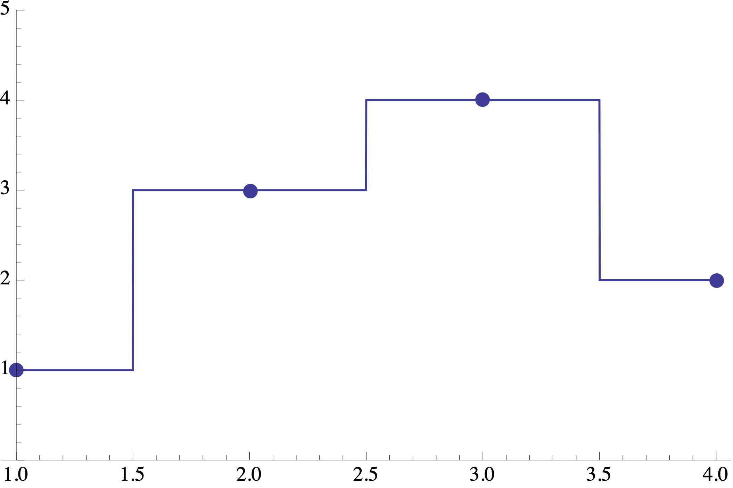
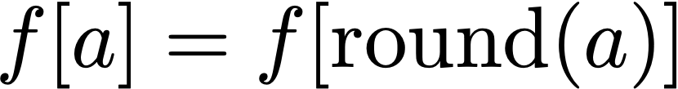
Nearest Neighbor
We assume the nearest neighbor here as same value as itself. Very fast but not good for images.
0th order

Slide 6
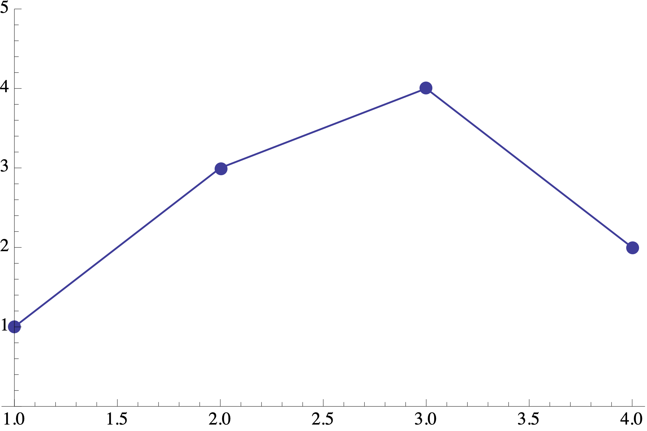
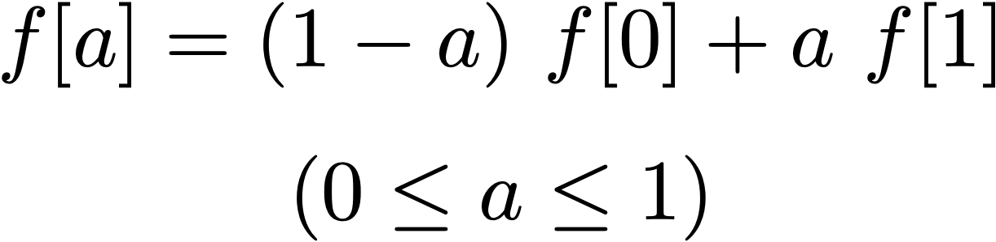
Linear Interpolation
Here we assume a line connects the sample values and assume the values in between according to that line.
This is a linear combination -ie alpha blend between 2 known values.
1st order

Slide 7
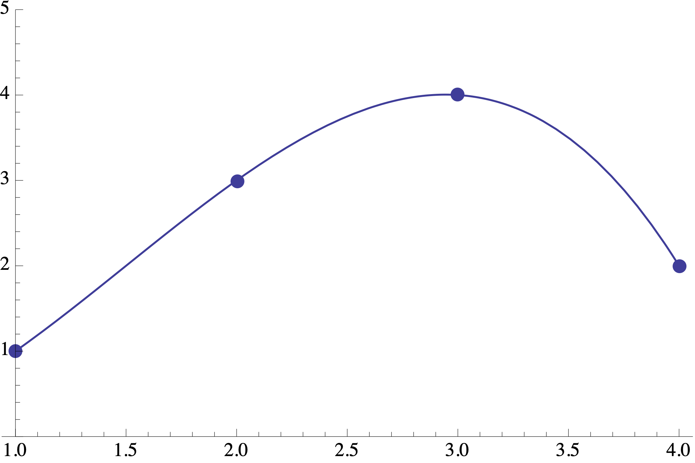
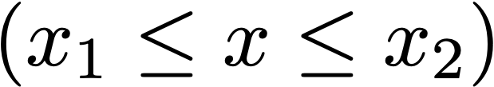
Cubic Interpolation
This fits a cubic curve along the points, gives a smoother and higher quality output but is also slower as we have to find many more values ie 3 independent values between points
To get the curve.
3rd order

Slide 8
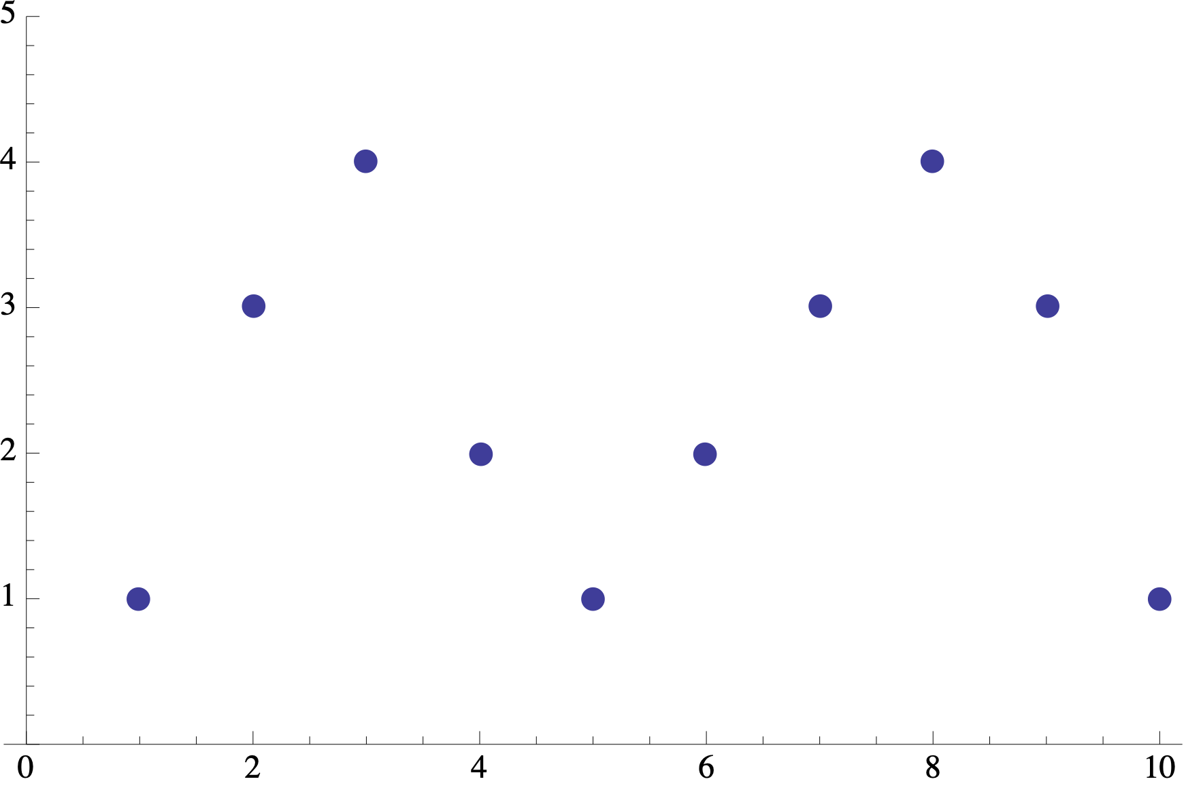
Longer Sequences
0th - nearest neighbor
1st - use one sample on both sides
3rd - use two samples on both sides

Slide 9



2D Images
Extend ideas of single-value interpolation
  Nearest neighbor
  Linear
  Cubic
  …

Slide 10
Nearest Neighbor
Ie when image is scaled, a pixel looks at the nearest neighbor and copies its value. Fast but quality is not that great
Same idea as in 1-d:
Round off to nearest pixel
Also called “pixel replication”
Big blocky pixels

Slide 11



Bilinear
Very common approach:
  Interpolate vertically
  Interpolate horizontally
  (or vice versa)
For linear interpolation, this is called bilinear
?

Slide 12
Example: Bilinear
Linearly interpolate in one direction:
Linearly interpolate between those in the other direction:
I(3,4) = 20
I(4,4) = 30
Ie get 40% of 30 because it is 0.6 farther away on the y-axis, then 60% of 80 since its closer.
I(3.8,4.6)=
54.4
?
I(3,5) = 40
I(4,5) = 80

Slide 13
Example: Bilinear (Slightly Easier Way)
Linearly interpolate in one direction:
Linearly interpolate between those in the other direction:
I(3,4) = 20
I(4,4) = 30
I(3.8,4.6) =
?
54.4
I(3,5) = 40
I(4,5) = 80

Slide 14
Bicubic
Same idea as bilinear but using a 4 x 4 grid of neighbors
Tends to produce sharper results
More computationally intensive

Slide 15
Generalizing Bilinear
Corner points don’t have to lie on a square or rectangle
Can be any quadrilateral
?

Slide 16
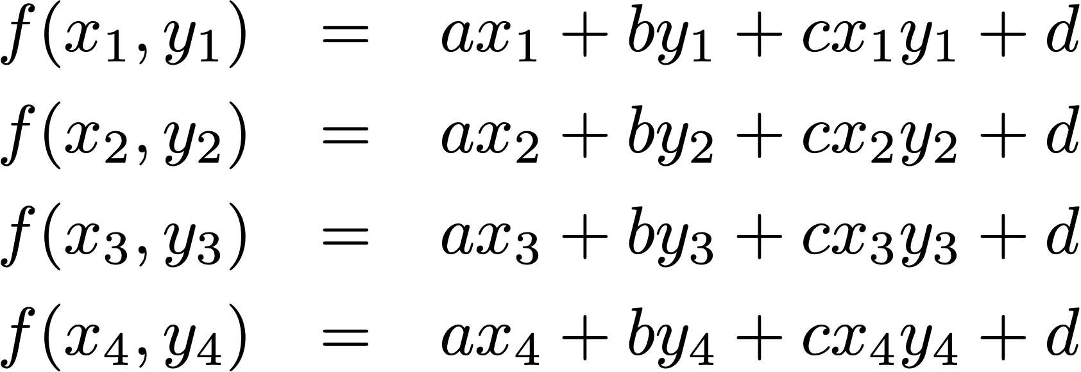
Generalized Bilinear
General form:
Use similar strategy as with curve fitting:
Solve for a, b, c, d and
plug into function
More on this later…

Slide 17
Mapping
How do we decide how to move points from discrete to continuous and back to discrete grid
Two Strategies
  Forward Mapping: Where do current points map to in the new space?
  Backward Mapping: Where the points in the new space map to in the current space?
Taking the original rectilinear image as all blue pixels, now mapping to a different image that has been projected means it has a different shape than rectilinear. But note that the shape of the screen is always rectilinear so
The final image just has the new pixels in a distorted place.

Slide 18




Forward Mapping
Input
Output

Slide 19
Forward Mapping
Problem: doesn’t map to discrete pixel locations
Input
Output

Slide 20
Forward Mapping
Problem: may produce holes in the output
?
Input
Output

Slide 21


Backward Mapping
Input
Output

Slide 22
Backward Mapping
Backward mapping is better to implement than forward mapping because we are always gauranteed that for any pixel location we fall back on the input image, we are sure
Of the 4 neighbors on that linear plane to easily get the new location of the new pixel.
Problem: doesn’t map from discrete pixel locations
Input
Output

Slide 23
Backward Mapping
Problem: may miss things in the input
Where
did it go?
Input
Output

Slide 24
Forward vs. Backward
See compose function in lab4 for backwards mapping
See details on midterm at sep 17th class.
5 math questions, 2 open ended questions ie given a scenario what options do you use
Not timed but he said should take about 2hrs.
Forward mapping:
Uses forward transformation
Have to spread effect
(“splatting”)
Parallel writes (slow)
May cause holes in output
Backward mapping:
Requires inverse transformation
Standard interpolation
(easy)
Parallel reads (fast)
May miss fine detail
and/or cause aliasing
if you can!

